Slide 1

3D Parallel Terrain Generation Using Perlin Noise
Explore how Perlin noise creates realistic 3D terrains using parallel processing.

Slide 2
GROUP MEMBERS:
LAIBA MAQSOOD (FA22-BCS-124)
HAMNA MUDASSAR (FA22-BCS-125)
SADIA USMAN (FA22-BCS-129)
MUHIRA ARSHAD (FA22-BCS-132)

Slide 3

What is Terrain Generation?
Terrain in digital environment is what makes a digital world feel like a real place.
3D terrain can interact from any angle, up close, far away,
from above or from within.
It’s not just a painting, we are sculpting it.
Components include Heightmaps, Mesh and Texture.

Slide 4
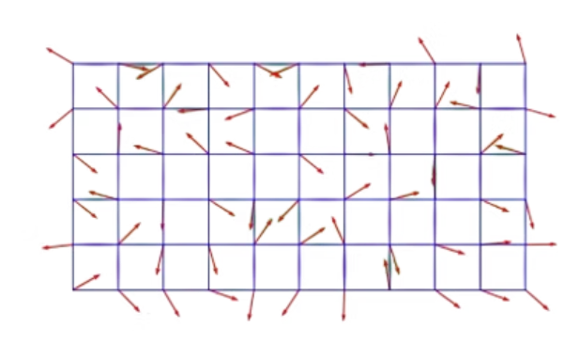
What is Perlin Noise?
Perlin Noise is a method to generate “natural looking random patterns”.
It was created by Ken Perlin in 1985 for Computer Graphics.
Features smooth, continuous pseudo-randomness ideal for creating terrain features like mountains, trees, clouds and waves etc.
Controlled by octaves, frequency, and amplitude
parameters.

Slide 5
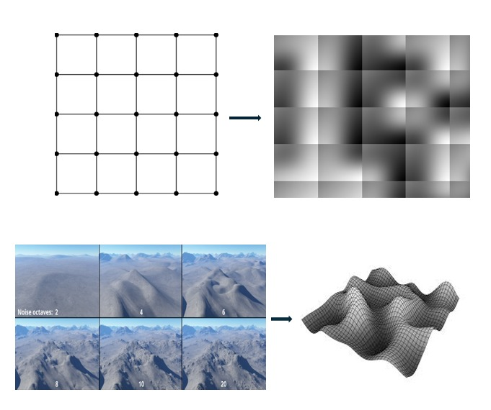
Perlin Noise for
3D Terrain
Create a 2D Grid
Apply Perlin Noise to get Smooth Noise Values.
Use Octaves to add more details and realism.
Convert 2D noise to 3D terrain mesh.
Visualize or use in simulation/game engine.

Slide 6
Methodology
Define Terrain Dimensions
Set size and resolution parameters
Height Map Initialization
Create a 2D float array of size N x N
Work Division
Chunk Partitioning and Load Balancing
Thread Execution
Each thread computes Perlin noise for its chunk.
Render the Terrain
Map the height map values onto a 3D Grid of vertices to create the visual terrain.

Slide 7
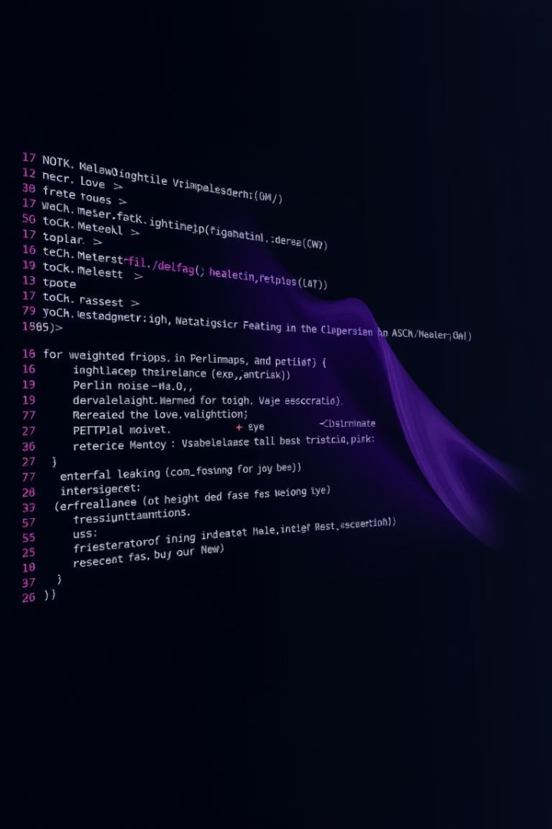
Algorithm
width, height
Initialize scale, octaves, persistence, lacunarity
Create 2D array terrain[height][width]
parallel for i from 0 to height - 1:
For j from 0 to width - 1:
x = j / scale
y = i / scale
noise_value = PerlinNoise(x, y, octaves, persistence,
lacunarity)
terrain[i][j] = noise_value

Slide 8





Programming Language and Tools
C++
OpenGL / DirectX
OpenMP
Handles performance-critical computation and memory management
Rendering libraries for 3D terrain visualization
Enables parallel processing to boost speed
Libraries
Libnoise: a portable c++ library for coherent noise generation.
Fastnoise: High performance noise generation library.

Slide 9
Serial vs. Parallel Time
Complexity
Aspect | Serial Execution | Parallel Execution
Grid Size | 500 x 500 | 500 x 500
Total Points | 250,000 | 250,000
Ops per Point | ~20 | ~20
Total Operations | 5 million ( single core) | 625,000 per core (8 cores)
Time Complexity | O(n²) = O(250K) | O(n² / p) = O(31.25K)
Time Taken | ~1.5 seconds | ~0.2–0.3 sec
Speed Up | 1× | ~6–7×
Serial complexity: O(n²) for an n x n grid
Parallel complexity: O(n² / p) with p processors ideally
Parallel overhead includes synchronization
and communication

Slide 10

Conclusion
Parallelism accelerates terrain generation significantly.
Perlin noise creates highly realistic landscapes.
Key applications: games, simulations, and VR.
Future advances: real-time editing and advanced noise models.

Slide 11
Thank You!

